Slide 1
Therapeutic potential of non-embryonic autologus stem cells and the justification for stem cell banking.
George Koliakos MD PhD
Department of Biological Chemistry Medical School Aristotle University Thessaloniki Greece.
Hellenic National Research Foundation Stem Cell Bank Athens Greece.

Slide 2
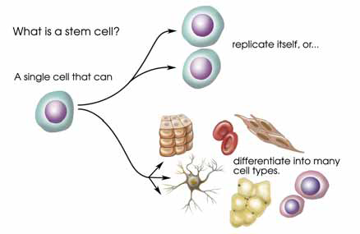
What are stem cells?
http://dels.nas.edu/resources/static-assets/materials-based-on reports/booklets/Understanding_Stem_Cells.pdf

Slide 3
What types of stem cells are known?
Embryonic stem cells
Embryonic stem cells (ESC) from the internal cell cluster
Embryonic Cancer Cells (ECC)
Non embryonic stem cells
Induced Pluripotent Stem cells (iPSC)
Very small Embryonic like stem cells (VSELSC)
Mesenchymal Stem Cells (MSC)
Unrestricted Stem Cells (USC)
Hematopoietic stem cells (HSC)
Multi Lineage Progenitor Cells (MLPC)
Peripheral blood monocytes (MC)

Slide 4
What are the sources of stem cells?
Blastocysts
Embryos
Umbilical cord Blood
Umbilical cord
Placenta
Amniotic fluid
Amniotic membranes
Dental pulp
Periodontic ligament
Adipose tissue
Bone marrow
Peripheral blood after activation
Skin and any other tissue
Any cell induced in the laboratory

Slide 5
Are non embryonic stem cells from all sources of equal value?

Slide 6
Acta Neurobiol Exp (Wars). 2006;66(4):293-300.
Human cord blood CD34+ cells and behavioral recovery following focal cerebral ischemia in rats.
Nystedt J, Mäkinen S, Laine J, Jolkkonen J. Research and Development, Finnish Red Cross Blood Service, Kivihaantie 7, 00310 Helsinki, Finland.

Slide 7
Bao X, Wei J, Feng M, Lu S, Li G, Dou W, Ma W, Ma S, An Y, Qin C, Zhao RC, Wang R.
Transplantation of human bone marrow-derived mesenchymal stem cells promotes behavioral recovery and endogenous neurogenesis after cerebral ischemia in rats.
Brain Res. 2011 Jan 7;1367:103-13.

Slide 8
Tissue Eng Part A. 2011 Jan 12. [Epub ahead of print]
Dental Pulp Derived CD31-/CD146- Side Population Stem/Progenitor Cells Enhance Recovery of Focal Cerebral Ischemia in Rats.
Sugiyama M, Iohara K, Wakita H, Hattori H, Ueda M, Matsushita K, Nakashima M. Nagoya
University Granduate School of Medicine , Oral and Maxillofacial Surgery, Laboratory Medicine , Nagoya, Aichi, Japan; m-sugi@med.nagoya-u.ac.jp.

Slide 9
Ikegame Y, Yamashita K, Hayashi Si et al
Comparison of mesenchymal stem cells from adipose tissue and bone marrow for ischemic stroke therapy.
Cytotherapy. 2011 Jan 13.

Slide 10
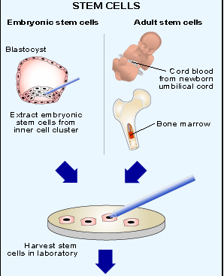
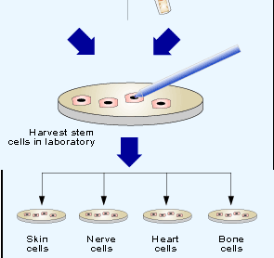
Embryonic and non Embryonic Stem Cells

Slide 11
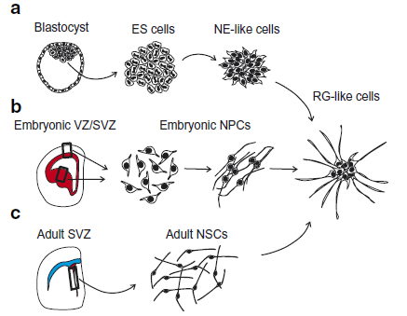
Non Embryonic stem cells in the brain
Paolo Malatesta & Irene Appolloni & Filippo Calzolari Cell Tissue Res (2008) 331:165–178

Slide 12
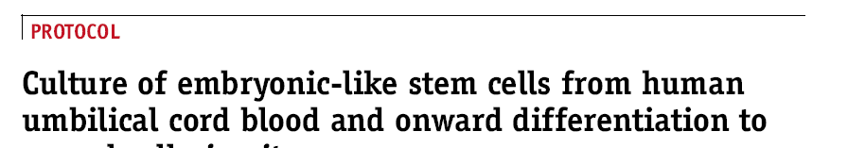
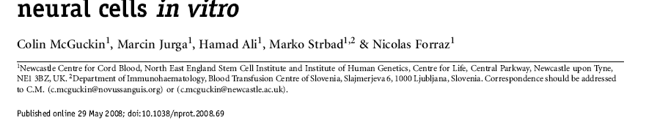

Slide 13
Embryonic vs non embryonic stem cells
Embryonic and iPSCs
Non embryonic
Can be differentiated into, practically any other cell type.
Can form embryonic bodies
Not rejected in autologus use (iPSC)
Can replace local cells and accelerate repair of tissues.
Can be used for ex vivo organ development.
Are immunologically “naïve” and may not be rejected in allogeneic or xenogeneic use before differentiation.
Can cause tumors (Teratomas).
Can be differentiated into, practically any other cell type.
Can home into the lesion site and induce cure
Are not rejected in autologus use
Support the local stem cells for tissue repair by secreting growth factors.
May replace local cells and accelerate repair of tissues.
Have been used for ex vivo organ development (trachea).
Some types (MSC) are immunologically “naïve” and may not be rejected in allogeneic or even xenogeneic use before differentiation.
Cannot cause tumors

Slide 14
Autologus versus allogeneic therapy
Autologus
Allogeneic
No risk of rejection or Graft Versus Host Disease
No need of immunosuppressive medication
Immediate availability of the graft.
No risk of contamination by the donor.
Need of preventive autologus storage.
Risk of rejection or Graft Versus Host Disease.
Immunosuppressive medication, often for life.
Long time search for compatible graft.
Risk of virus contamination by the donor.
Need for repositories or development of expensive “omnidonor” cell lines.

Slide 15
Non embryonic stem cell therapies: mimicry of a natural process

Slide 16
Non embryonic stem cell therapies: mimicry of a natural process (Continued)

Slide 17
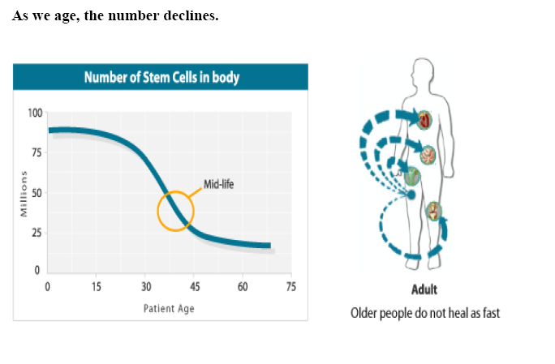
Non embryonic stem cell therapies: mimicry of a natural process (Continued)

Slide 18
Non embryonic stem cell therapies: mimicry of a natural process (Continued)

Slide 19
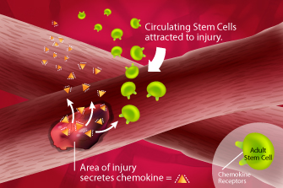
How Stem Cells Repair Damaged Tissue
Area of injury secretes chemokine.
Circulating Stem Cells are attracted to chemokine.

Slide 20
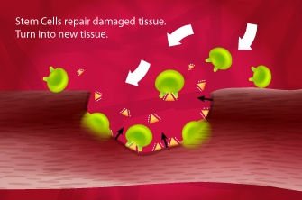
How Stem Cells Repair Damaged Tissue
(Continued)
Stem Cells repair damaged tissue…
Turn into new tissue.

Slide 21
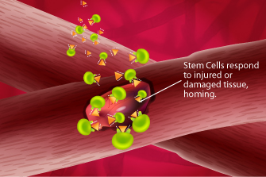
How Stem Cells Repair Damaged Tissue
(Continued)
Stem Cells respond to injured or damaged tissue.
This is called homing.

Slide 22
Plast Reconstr Surg. 2011 Mar;127(3):1130-40.
Studies in adipose-derived stromal cells: migration and participation in repair of cranial injury after systemic injection.
Levi B, James AW, Nelson ER, Hu S, Sun N, Peng M, Wu J, Longaker MT.
Hagey Pediatric Regenerative Research Laboratory, Department of Surgery, Plastic and Reconstructive Surgery Division, Stanford University School of Medicine, Stanford, Calif. 94305-5148, USA.

Slide 23
Are cells collected at birth or a young age better suited for therapies ?
“The amount of Non embryonic Stem Cells decreases with age and infirmity. The greatest number of Non embryonic Stem cells is found in neonates, then it is reduced during the lifespan about one-half at the age of 80!”
Roobrouck VD, Ulloa-Montoya F, Verfaillie CM. Self-renewal and differentiation capacity of young and aged stem cells. Exp Cell Res. 2008 Jun 10;314(9):1937-44.
Wagner W, Bork S, Horn P, Krunic D, Walenda T, Diehlmann A, Benes V, Blake J, Huber FX, Eckstein V, Boukamp P, Ho AD. Aging and replicative senescence have related effects on human stem and progenitor cells. PLoS One. 2009 Jun 9;4(6):e5846.

Slide 24
Aging and Replicative Senescence Have Related Effects on Human Stem and Progenitor Cells
Wolfgang Wagner et al 2009 Cells. PLoS ONE 4(6): e5846.doi: 10.1371/journal.pone.0005846
“MSC were isolated from bone marrow of donors between 21 and 92 years old. 67 genes were age-induced and 60 were age-repressed. HPC were isolated from cord blood or from mobilized peripheral blood of donors between 27 and 73 years and 432 genes were age-induced and 495 were age-repressed.”

Slide 25
Curr Opin Immunol. 2009 Aug;21(4):408-13. Epub 2009 Jun 6.
Effects of aging on hematopoietic stem and progenitor cells.
Waterstrat A, Van Zant G.
“aged hematopoietic stem and progenitor cells (HSPCs) differ from their younger counterparts in functional capacity, the complement of proteins on the cell surface, transcriptional activity, and genome integrity”

Slide 26
Nat Rev Mol Cell Biol. 2007 Sep;8(9):703-13.
How stem cells age and why this makes us grow old.
Sharpless NE, DePinho RA.
Source
Department of Medicine, The Lineberger Comprehensive Cancer Center, The University of North Carolina, Chapel Hill, North Carolina 27599-7295, USA. nes@med.unc.edu
Abstract
Recent data suggest that we age, in part, because our self-renewing stem cells grow old as a result of heritable intrinsic events, such as DNA damage, as well as extrinsic forces, such as changes in their supporting niches. Mechanisms that suppress the development of cancer, such as senescence and apoptosis, which rely on telomere shortening and the activities of p53 and p16(INK4a), may also induce an unwanted consequence: a decline in the replicative function of certain stem-cell types with advancing age. This decreased regenerative capacity appears to contribute to some aspects of mammalian ageing, with new findings pointing to a 'stem-cell hypothesis' for human age-associated conditions such as frailty, atherosclerosis and type 2 diabetes.

Slide 27
Exp Cell Res. 2008 Jun 10;314(9):1937-44. Epub 2008 Mar 20.
Self-renewal and differentiation capacity of young and aged stem cells.
Roobrouck VD, Ulloa-Montoya F, Verfaillie CM.
Source
Stem Cell Institute Leuven, University of Leuven, Leuven, Belgium.
Abstract
Because of their ability to self-renew and differentiate, adult stem cells are the in vivo source for replacing cells lost on a daily basis in high turnover tissues during the life of an organism. Adult stem cells however, do suffer the effects of aging resulting in decreased ability to self-renew and properly differentiate. Aging is a complex process and identification of the mechanisms underlying the aging of (stem) cell population(s) requires that relatively homogenous and well characterized populations can be isolated. Evaluation of the effect of aging on one such adult stem cell population, namely the hematopoietic stem cell (HSC), which can be purified to near homogeneity, has demonstrate that they do suffer cell intrinsic age associated changes. The cells that support HSC, namely marrow stromal cells, or mesenchymal stem cells (MSC), may similarly be affected by aging, although the inability to purify these cells to homogeneity precludes definitive assessment. As HSC and MSC are being used in cell-based therapies clinically, improved insight in the effect of aging on these two stem cell populations will probably impact the selection of sources for these stem cells.

Slide 28
Can frozen cells be utilized for therapy?

Slide 29
Bone Marrow Transplant. 1997 Jun;19(11):1079-84.
Clonogenic capacity and ex vivo expansion potential of umbilical cord blood progenitor cells are not impaired by cryopreservation.
Almici C, Carlo-Stella C, Wagner JE, Mangoni L, Garau D, Re A, Giachetti R, Cesana C, Rizzoli V.
Department of Hematology, University of Parma, Italy.

Slide 30
Stem Cells. 2005 May;23(5):681-8.
Cryopreservation does not affect proliferation and multipotency of murine neural precursor cells.
Milosevic J, Storch A, Schwarz J.
Source
Department of Neurology, University of Leipzig, Leipzig, Germany. javorina.milosevic@medizin.uni-leipzig.de

Slide 31
Tissue Eng Part C Methods. 2010 Aug;16(4):771-81.
Cryopreservation does not affect the stem characteristics of multipotent cells isolated from equine peripheral blood.
Martinello T, Bronzini I, Maccatrozzo L, Iacopetti I, Sampaolesi M, Mascarello F, Patruno M.
Source
Department of Experimental Veterinary Sciences, University of Padova, Legnaro, Italy.

Slide 32
In Vitro Cell Dev Biol Anim. 2011 Jan;47(1):54-63. Epub 2010 Nov 17.
Differentiating of banked human umbilical cord blood-derived mesenchymal stem cells into insulin-secreting cells.
Phuc PV, Nhung TH, Loan DT, Chung DC, Ngoc PK.
Source
Laboratory of Stem Cell Research and Application, University of Science, Vietnam National University, Hanoi, Vietnam. pvphuc@hcmuns.edu.vn

Slide 33
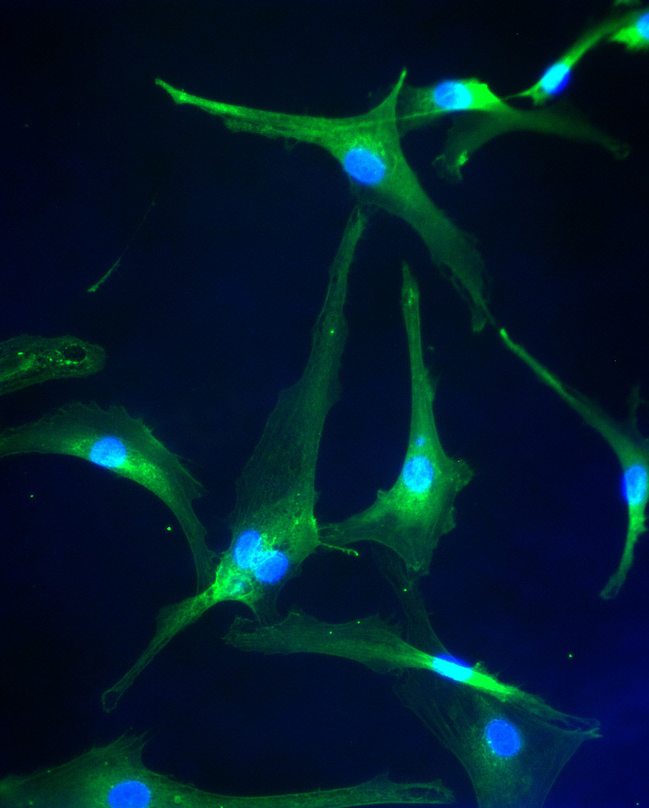
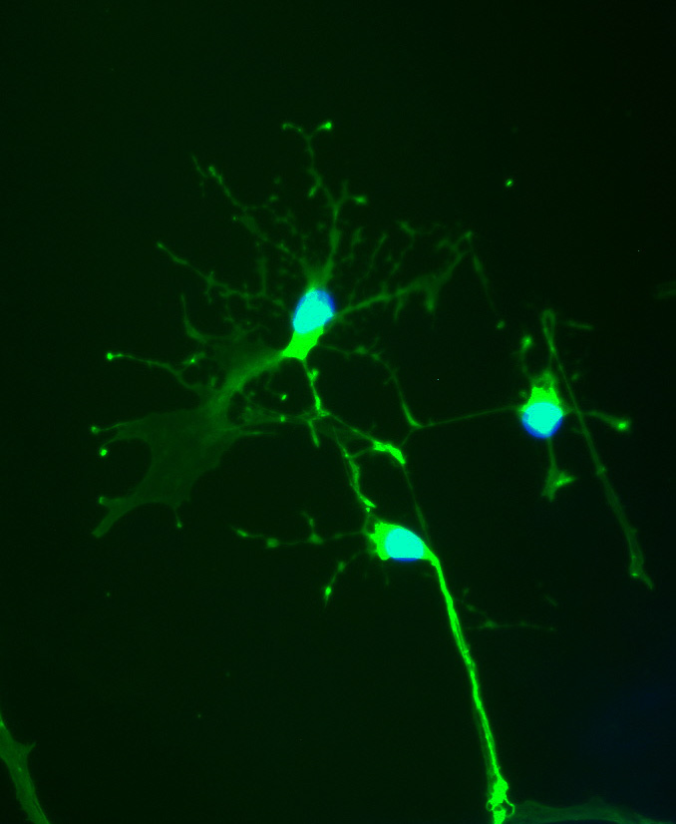
GFP positive Neural like cells derived from GFP positive adipose tissue derived cryopreserved mesenchymal stem cells
S. Petrakis et al unpublished data

Slide 34
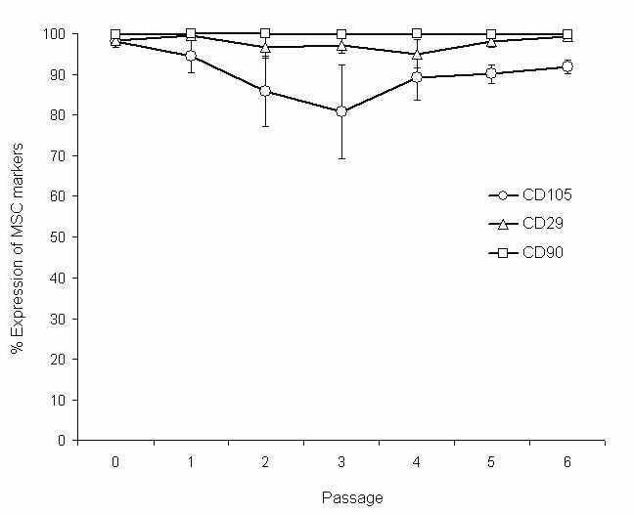
Isolated stem cells maintained their characteristics
after the passages and after post thaw
Mean ± SD percentage expression of MSC markers of three samples from P0 to P6. Error bars denote standard deviation

Slide 35
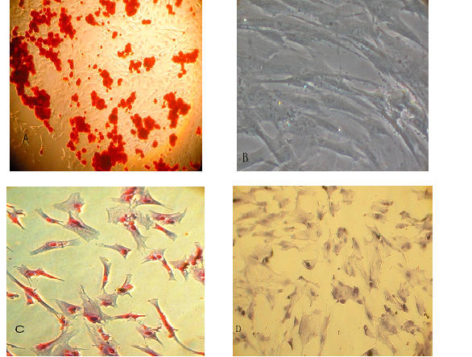
Plasticity of cord stem cells
Osteogenic (A) and adipogenic (C) differentiation of the cryopreserved mesenchymal stem cells from the placental perfusion. Formation of mineralized matrix by Alizarin Red evidenced osteogenic differentiation. Adipogenic differentiation was evidenced by the formation of lipid vacuoles by oil-red O staining. Control mesenchymal stem cells were grown in regular medium (B), (D).
Tsagias N, Koliakos I, Karagiannis V, Eleftheriadou M, Koliakos GG. Isolation of mesenchymal stem cells using the total length of umbilical cord for transplantation purposes. Transfus Med. 2011 Aug;21(4):253-61.

Slide 36
Storing stem cells for future use
At birth
During life
Cord blood
Wharton’s jelly
Placenta
Amniotic fluid
Amniotic membrane
Dental pulp
Periodontic ligament
Adipose tissue
Bone marrow
Peripheral blood after activation

Slide 37
Stem cell banking
At birth
At the age of deciduous teeth replacement
After an aesthetic surgery (e.g.liposuction)
During a bone marrow or peripheral blood “donation” to myself
During any dental or other surgery
After stem cell collection for autologus therapy
Temporary storing until Quality control is completed
Storing cells for repeating the therapy

Slide 38
Stem cell therapies
PubMed database search August 2011
“autologus” AND “stem cells” AND “therapy”
gave 4299 hits.
AND “clinical” gave 1903 hits.

Slide 39
Stem Cells Dev. 2011 Mar 17. [Epub ahead of print]
Safety of Intravenous Infusion of Human Adipose Tissue-Derived Mesenchymal Stem Cells in Animals and Humans.
Ra JC, Shin IS, Kim SH, Kang SK, Kang BC, Lee HY, Kim YJ, Jo JY, Yoon EJ, Choi HJ, Kwon E.
1 Stem Cell Research Center , RNL Bio Co., Ltd., Seoul, Republic of Korea.

Slide 40
Non embryonic Stem cell treatments
Plastic surgery and wound healing
Facial and skin rejuvenation (adipose tissue)
Burns and wound healing (bone marrow and adipose tissue)
Breast augmentation after lumpectomy (adipose tissue)
Alopecia (adipose tissue)
Diabetic ulcer healing (bone marrow and adipose tissue)
Radiation wound healing (bone marrow and adipose tissue)

Slide 41
Cytotherapy. 2011 Jul;13(6):705-11. Epub 2011 Feb 2.
Treatment of non-healing wounds with autologous bone marrow cells, platelets, fibrin glue and collagen matrix.
Ravari H, Hamidi-Almadari D, Salimifar M, Bonakdaran S, Parizadeh MR, Koliakos G.
Vascular and Endovascular Research Center, Imamreza Hospital, Mashhad University of Medical Sciences, Mashhad, Iran.
BACKGROUND AIMS:
Recalcitrant diabetic wounds are not responsive to the most common treatments. Bone marrow-derived stem cell transplantation is used for the healing of chronic lower extremity wounds.
METHODS:
We report on the treatment of eight patients with aggressive, refractory diabetic wounds. The marrow-derived cells were injected/applied topically into the wound along with platelets, fibrin glue and bone marrow-impregnated collagen matrix.
RESULTS:
Four weeks after treatment, the wound was completely closed in three patients and significantly reduced in the remaining five patients.
CONCLUSIONS:
Our study suggests that the combination of the components mentioned can be used safely in order to synergize the effect of chronic wound healing.

Slide 42
Exp Dermatol. 2011 May;20(5):383-7
Adipose-derived stem cells as a new therapeutic modality for ageing skin.
Kim JH, Jung M, Kim HS, Kim YM, Choi EH.
Department of Dermatology, Yonsei University Wonju College of Medicine, Wonju, Korea.

Slide 43
Neurosurgery. 2011 Feb 16. [Epub ahead of print]
Cranioplasty with adipose-derived stem cells and biomaterial. A novel method for cranial reconstruction.
Thesleff T, Lehtimäki K, Niskakangas T, Mannerström B, Miettinen S, Suuronen R, Ohman J.
1Department of Neurosurgery, Tampere University Hospital, Tampere, Finland; 2REGEA Institute for Regenerative Medicine, University of Tampere, Tampere, Finland; 3Department of Eye, Ear and Oral Diseases, Tampere University Hospital, Tampere, Finland; 4Institute of Biomedical Engineering, Tampere University of Technology, Tampere, Finland.

Slide 44
Non embryonic Stem cell treatments
Cardiology -cardiosurgery
Heart insufficiency (bone marrow and adipose tissue)
Acute Infarct (bone marrow and adipose tissue)
Ischemic myocardium (bone marrow and adipose tissue)
Cardiac valves regeneration (bone marrow)

Slide 45
Eur J Heart Fail. 2010 Feb;12(2):172-80. Epub 2009 Dec 30.
Bone marrow cell transplantation improves cardiac, autonomic, and functional indexes in acute anterior myocardial infarction patients (Cardiac Study).
Piepoli MF, Vallisa D, Arbasi M, Cavanna L, Cerri L, Mori M, Passerini F, Tommasi L, Rossi A, Capucci A; Cardiac Study Group.
Department of Cardiology, Guglielmo da Saliceto Polichirurgico Hospital, Piacenza 29100, Italy. m.piepoli@ausl.pc.it

Slide 46
Am Heart J. 2011 Jun;161(6):1078-87.
A randomized study of transendocardial injection of autologous bone marrow mononuclear cells and cell function analysis in ischemic heart failure (FOCUS-HF).
Perin EC, et al .Stem Cell Center, Texas Heart Institute, St Luke's Episcopal Hospital, Houston, TX, USA. eperin@bluegate.com
Cell-treated (n = 20) and control patients (n = 10) were similar at baseline. The procedure was safe; adverse events were similar in both groups. Canadian Cardiovascular Society angina score improved significantly (P = .001) in cell-treated patients, but function was not affected. Quality-of-life scores improved significantly at 6 months (P = .009 Minnesota Living with Heart Failure and P = .002 physical component of Short Form 36) over baseline in cell-treated but not control patients. Single photon emission computed tomography data suggested a trend toward improved perfusion in cell-treated patients. The proportion of fixed defects significantly increased in control (P = .02) but not in treated patients (P = .16). Function of patients' bone marrow mononuclear cells was severely impaired. Stratifying cell results by age showed that younger patients (≤60 years) had significantly more mesenchymal progenitor cells (colony-forming unit fibroblasts) than patients >60 years (20.16 ± 14.6 vs 10.92 ± 7.8, P = .04). Furthermore, cell-treated younger patients had significantly improved maximal myocardial oxygen consumption (15 ± 5.8, 18.6 ± 2.7, and 17 ± 3.7 mL/kg per minute at baseline, 3 months, and 6 months, respectively) compared with similarly aged control patients (14.3 ± 2.5, 13.7 ± 3.7, and 14.6 ± 4.7 mL/kg per minute, P = .04).

Slide 47
Scand Cardiovasc J. 2011 Jun;45(3):161-8. Epub 2011 Apr 12.
Mesenchymal stromal cell derived endothelial progenitor treatment in patients with refractory angina.
Friis T, Haack-Sørensen M, Mathiasen AB, Ripa RS, Kristoffersen US, Jørgensen E, Hansen L, Bindslev L, Kjær A, Hesse B, Dickmeiss E, Kastrup J.
Cardiac Stem Cell Laboratory and Catheterization Laboratory 2014, The Hearth Centre, Rigshospitalet Copenhagen University Hospital, Copenhagen, Denmark.
AIMS:
We evaluated the feasibility, safety and efficacy of intra-myocardial injection of autologous mesenchymal stromal cells derived endothelial progenitor cell (MSC) in patients with stable coronary artery disease (CAD) and refractory angina in this first in man trial.
METHODS AND RESULTS:
A total of 31 patients with stable CAD, moderate to severe angina and no further revascularization options, were included. Bone marrow MSC were isolated and culture expanded for 6-8 weeks. It was feasible and safe to establish in-hospital culture expansion of autologous MSC and perform intra-myocardial injection of MSC. After six months follow-up myocardial perfusion was unaltered, but the patients increased exercise capacity (p < 0.001), reduction in CCS Class (p < 0.001), angina attacks (p < 0.001) and nitroglycerin consumption (p < 0.001), and improved Seattle Angina Questionnaire (SAQ) evaluations (p < 0.001). For all parameters there was a tendency towards improved outcome with increasing numbers of cells injected. In the MRI substudy: ejection fraction (p < 0.001), systolic wall thickness (p = 0.03) and wall thickening (p = 0.03) all improved.
CONCLUSIONS:
The study demonstrated that it was safe to treat patients with stable CAD with autologous culture expanded MSC. Moreover, MSC treated patients had significant improvement in left ventricular function and exercise capacity, in addition to an improvement in clinical symptoms and SAQ evaluations.

Slide 48
Int J Cardiol. 2011 Aug 16. [Epub ahead of print]
Stem cells transplantation combined with long-term mechanical circulatory support enhances myocardial viability in end-stage ischemic cardiomyopathy.
Anastasiadis K, Antonitsis P, Doumas A, Koliakos G, Argiriadou H, Vaitsopoulou C, Tossios P, Papakonstantinou C, Westaby S.
Department of Cardiothoracic Surgery, AHEPA University Hospital, Thessaloniki, Greece.

Slide 49
Non embryonic Stem cell treatments
Neurology
Cerebral palsy (umbilical cord blood)
Autism (adipose tissue)
Alzheimer (bone marrow and adipose tissue)
Parkinson disease (bone marrow and adipose tissue)
Multiple sclerosis (bone marrow and adipose tissue)
ALS (adipose tissue)
Stroke (bone marrow)
Spinal injury (Umbilical cord blood)

Slide 50
Exp Clin Transplant. 2009 Dec;7(4):241-8.
Autologous bone marrow derived mononuclear cell therapy for spinal cord injury: A phase I/II clinical safety and primary efficacy data.
Kumar AA, Kumar SR, Narayanan R, Arul K, Baskaran M.
Source
Department of Stem Cells, Lifeline Institute of Regenerative Medicine, Rajiv Gandhi Salai, Perungudi, Chennai.
OBJECTIVE:
We sought to assess the safety and therapeutic efficacy of autologous human bone marrow derived mononuclear cell transplantation on spinal cord injury in a phase I/II, nonrandomized, open-label study, conducted on 297 patients.
MATERIALS AND METHODS:
We transplanted unmanipulated bone marrow mononuclear cells through a lumbar puncture, and assessed the outcome using standard neurologic investigations and American Spinal Injury Association (ASIA) protocol, and with respect to safety, therapeutic time window, CD34-/+ cell count, and influence on sex and age.
RESULTS:
No serious complications or adverse events were reported, except for minor reversible complaints. Sensory and motor improvements occurred in 32.6% of patients, and the time elapsed between the injury and the treatment considerably influenced the outcome of the therapy. The CD34-/+ cell count determined the state of improvement, or no improvement, but not the degree of improvement. No correlation was found between level of injury and improvement, and age and sex had no role in the outcome of the cellular therapy.
CONCLUSION:
Transplant of autologous human bone marrow derived mononuclear cells through a lumbar puncture is safe, and one-third of spinal cord injury patients show perceptible improvements in the neurologic status. The time elapsed between injury and therapy and the number of CD34-/+ cells injected influenced the outcome of the therapy.

Slide 51
Brain. 2011 Jun;134(Pt 6):1790-807. Epub 2011 Apr 14.
Intravenous administration of auto serum-expanded autologous mesenchymal stem cells in stroke.
Honmou O, Houkin K, Matsunaga T, Niitsu Y, Ishiai S, Onodera R, Waxman SG, Kocsis JD.
Department of Neural Repair and Therapeutics, Sapporo Medical University, South-1st, West-16th, Chuo-ku, Sapporo, Hokkaido 060-8543, Japan. honmou@sapmed.ac.jp
Abstract
We report an unblinded study on 12 patients with ischaemic grey matter, white matter and mixed lesions, in contrast to a prior study on autologous mesenchymal stem cells expanded in foetal calf serum that focused on grey matter lesions. Cells cultured in human serum expanded more rapidly than in foetal calf serum, reducing cell preparation time and risk of transmissible disorders such as bovine spongiform encephalomyelitis. Autologous mesenchymal stem cells were delivered intravenously 36-133 days post-stroke. All patients had magnetic resonance angiography to identify vascular lesions, and magnetic resonance imaging prior to cell infusion and at intervals up to 1 year after. Magnetic resonance perfusion-imaging and 3D-tractography were carried out in some patients. Neurological status was scored using the National Institutes of Health Stroke Scale and modified Rankin scores. We did not observe any central nervous system tumours, abnormal cell growths or neurological deterioration, and there was no evidence for venous thromboembolism, systemic malignancy or systemic infection in any of the patients following stem cell infusion. The median daily rate of National Institutes of Health Stroke Scale change was 0.36 during the first week post-infusion, compared with a median daily rate of change of 0.04 from the first day of testing to immediately before infusion. Daily rates of change in National Institutes of Health Stroke Scale scores during longer post-infusion intervals that more closely matched the interval between initial scoring and cell infusion also showed an increase following cell infusion. Mean lesion volume as assessed by magnetic resonance imaging was reduced by >20% at 1 week post-cell infusion. While we would emphasize that the current study was unblinded, did not assess overall function or relative functional importance of different types of deficits, and does not exclude placebo effects or a contribution of recovery as a result of the natural history of stroke, our observations provide evidence supporting the feasibility and safety of delivery of a relatively large dose of autologous mesenchymal human stem cells, cultured in autologous human serum, into human subjects with stroke and support the need for additional blinded, placebo-controlled studies on autologous mesenchymal human stem cell infusion in stroke.

Slide 52
Non embryonic Stem cell treatments
Orthopedics
Arthritis (bone marrow and adipose tissue)
Joint trauma (bone marrow and adipose tissue)
Bone regeneration (bone marrow and adipose tissue)
Refractory bone fractions (bone marrow and adipose tissue)

Slide 53
Arthroscopy. 2011 Apr;27(4):493-506. Epub 2011 Feb 19.
Articular cartilage regeneration with autologous peripheral blood progenitor cells and hyaluronic acid after arthroscopic subchondral drilling: a report of 5 cases with histology.
Saw KY, Anz A, Merican S, Tay YG, Ragavanaidu K, Jee CS, McGuire DA.
Kuala Lumpur Sports Medicine Centre, Kuala Lumpur, Malaysia. sportsclinic@hotmail.com

Slide 54
J Cell Physiol. 2010 Nov;225(2):291-5.
Articular cartilage repair with autologous bone marrow mesenchymal cells.
Matsumoto T, Okabe T, Ikawa T, Iida T, Yasuda H, Nakamura H, Wakitani S.
Department of Orthopaedic Surgery, Osaka City University Graduate School of Medicine, Abeno-ku, Osaka, Japan.

Slide 55
J Med Assoc Thai. 2011 Mar;94(3):395-400.
Autologous bone marrow mesenchymal stem cells implantation for cartilage defects: two cases report.
Kasemkijwattana C, Hongeng S, Kesprayura S, Rungsinaporn V, Chaipinyo K, Chansiri K.
Department of Orthopedics, Faculty of Medicine, HRH Princess Maha Chakri Sirindhorn Medical Center, Srinakhrinwirot University, Nakhon Nayok, Thailand. chann@swu.ac.th

Slide 56
Non embryonic Stem cell treatments
Other medical specialties
Diabetes (umbilical cord blood adipose tissue)
Pulmonary fibrosis (adipose tissue Bouros et al manuscript in preparation)
Emphysema (adipose tissue)
Endometium regeneration (bone marrow and adipose tissue)
Breast augmentation after lumpectomy (adipose tissue)
Cornea wound healing (adipose tissue)
Urinary incontinence (bone marrow)
Crone disease (Bone marrow and adipose tissue)
Liver disease (bone marrow)

Slide 57
Gut. 2010 Dec;59(12):1662-9. Epub 2010 Oct 4.
Autologous bone marrow-derived mesenchymal stromal cell treatment for refractory luminal Crohn's disease: results of a phase I study.
Duijvestein M, Vos AC, Roelofs H, Wildenberg ME, Wendrich BB, Verspaget HW, Kooy-Winkelaar EM, Koning F, Zwaginga JJ, Fidder HH, Verhaar AP, Fibbe WE, van den Brink GR, Hommes DW.
Department of Gastroenterology and Hepatology, Leiden University Medical Center, Albinusdreef 2, 2333 ZA Leiden, The Netherlands. m.duijvestein@lumc.nl
BACKGROUND AND AIM:
Mesenchymal stromal cells (MSCs) are pluripotent cells that have immunosuppressive effects both in vitro and in experimental colitis. Promising results of MSC therapy have been obtained in patients with severe graft versus host disease of the gut. Our objective was to determine the safety and feasibility of autologous bone marrow derived MSC therapy in patients with refractory Crohn's disease.
PATIENTS AND INTERVENTION:
10 adult patients with refractory Crohn's disease (eight females and two males) underwent bone marrow aspiration under local anaesthesia. Bone marrow MSCs were isolated and expanded ex vivo. MSCs were tested for phenotype and functionality in vitro. 9 patients received two doses of 1-2×10(6) cells/kg body weight, intravenously, 7 days apart. During follow-up, possible side effects and changes in patients' Crohn's disease activity index (CDAI) scores were monitored. Colonoscopies were performed at weeks 0 and 6, and mucosal inflammation was assessed by using the Crohn's disease endoscopic index of severity.
RESULTS:
MSCs isolated from patients with Crohn's disease showed similar morphology, phenotype and growth potential compared to MSCs from healthy donors. Importantly, immunomodulatory capacity was intact, as Crohn's disease MSCs significantly reduced peripheral blood mononuclear cell proliferation in vitro. MSC infusion was without side effects, besides a mild allergic reaction probably due to the cryopreservant DMSO in one patient. Baseline median CDAI was 326 (224-378). Three patients showed clinical response (CDAI decrease ≥70 from baseline) 6 weeks post-treatment; conversely three patients required surgery due to disease worsening.
CONCLUSIONS:
Administration of autologous bone marrow derived MSCs appears safe and feasible in the treatment of refractory Crohn's disease. No serious adverse events were detected during bone marrow harvesting and administration.

Slide 58
Autologous CD34+ and CD133+ stem cells transplantation in
patients with end stage liver disease
Hosny Salama et al El-Kasr Al-Aini School of Medicine Egypt
World J Gastroenterol 2010 November 14; 16(42): 5297-5305
One hundred and forty patients with endstage liver diseases were randomized into two groups.
Group 1, comprising 90 patients, received granulocyte colony stimulating factor for five days followed by autologous CD34+ and CD133+ stem cell infusion in the
portal vein.
Group 2, comprising 50 patients, received regular liver treatment only and served as a control group.
Near normalization of liver enzymes and improvement in synthetic function were observed in 54.5% of the group 1 patients; 13.6% of the patients showed stable states in the infused group. None of the patients in the control group showed improvement. No
adverse effects were noted.

Slide 59
Heart Vessels. 2009 Sep;24(5):321-8. Epub 2009 Sep 27.
Meta-analysis of randomized, controlled clinical trials in angiogenesis: gene and cell therapy in peripheral arterial disease.
De Haro J, Acin F, Lopez-Quintana A, Florez A, Martinez-Aguilar E, Varela C.
Angiology and Vascular Surgery Service, Hospital Universitario Getafe, Madrid, Spain. deharojoaquin@yahoo.es
We aim to determine the efficacy and safety of gene and cell angiogenic therapies in the treatment of peripheral arterial disease (PAD) and evaluate them for the first time by a meta-analysis. We include in the formal meta-analysis only the randomized placebo-controlled phase 2 studies with any angiogenic gene or cell therapy modality to treat patients with PAD (intermittent claudication, ulcer or critical ischemia) identified by electronic search in MEDLINE and EMBASE databases (1980 to date). Altogether, 543 patients are analyzed from six randomized, controlled trials that are comparable with regard to patient selection, study design, and endpoints. We perform the meta-analysis regarding clinical improvement (improvement of peak walk time, relief in rest pain, ulcer healing or limb salvage) and rate of adverse events. At the end of treatment, therapeutic angiogenesis shows a significantly clinical improvement as compared to placebo in patients with PAD (odds ratio [OR] = 1.437; 95% confidence interval [CI] = 1.03-2.00; P = 0.033). The response rate (improvement of peak walk time) of the pooled groups according to clinical severity does not significantly differ for gene therapy as compared with placebo in the treatment of claudicating patients (OR = 1.304; 95% CI = 0.90-1.89; P = 0.16). Otherwise, we find significant efficacy of the treatment in critical ischemia (OR = 2.20; 95% CI = 1.01-4.79; P = 0.046). The adverse events rates show a slightly significantly higher risk of potential nonserious adverse events (edema, hypotension, proteinuria) in the treated group (OR = 1.81; 95% CI = 1.01-3.38; P = 0.045). We find no differences in mortality from any cause, malignancy, or retinopathy. The patients with PAD, and particularly those with critical ischemia, improve their symptoms when treated with angiogenic gene and cell therapy with acceptable tolerability.

Slide 60
Conclusions
Autologus non Embryonic stem cells (ANESCs) can be safely used for treatment of patients in applications considering many medical specialties.
ANESCs age therefore young cells are better suited for therapies than older cells.
Young ANESCs safely preserved in liquid nitrogen for many years can be successfully used in future autologus cell therapies.

